Slide 1
IMDB Movie Analysis
SAKSHI RAHIWAL
IMDB_Movies Excel report.xlsx

Slide 2
Agenda
Project Description
Approach
Tech-Stack used
Insights
Results

Slide 3
PROJECT DESCRIPTION
In this project we will perform data analysis on dataset
of IMDB movies, we will frame many question and find
answer to it.
We will clean the dataset and remove errors, blanks to increase the dataset quality.
We will solve some task like movie duration, language, director etc.

Slide 4
My major tasks in this project as follows:
To clean the data
Movie Genre Analysis
Movie Duration Analysis
Language Analysis
Director Analysis
Budget Analysis

Slide 5
Approach
My first step is to import dataset csv file to MS Excel and convert it from tables to range.
Next I will frame some question based on ‘why’ approach like
- Why do movies with higher budgets tend to have higher rating.
- Why does an enhanced viewer experience lead to higher rating.
Now I will clean the data by dropped the blank cell row, remove outliers, removed duplicates, removing useless columns from dataset etc.
Now I will use some Excel function like COUNTIF, SUM, AVERAGE, MEDIAN, MODE, STDEV for statistical calculation.
I will use pivot table to visualize data.

Slide 6
TECH-STACK USED
Microsoft Excel (Version-2019)
MS Excel reduce time and mainly use for analysing data it provide various feature for mathematical calculation and also help in visualizing data which is useful for data analysis and prediction.

Slide 7
INSIGHTS
In this project we can see various type of observation each task have different outputs

Slide 8
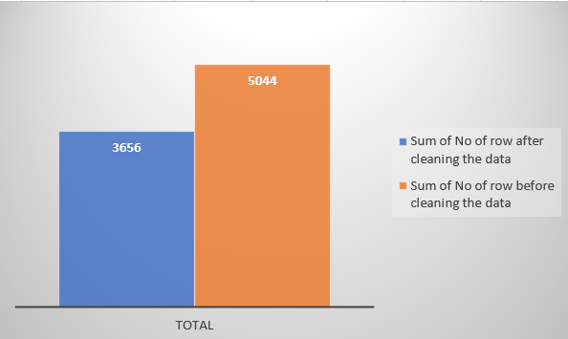
To clean Data
First import the dataset in MS Excel.
Drop the blank or null value rows and columns.
Remove duplicate data
Delete or drop the useless columns from the dataset
Insert more column as requirement.

Slide 9
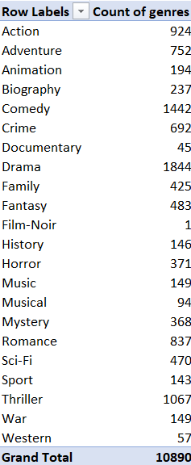
Movie Genre Analysis
Import your dataset into Excel, making sure it includes columns for "Genre" and "IMDB Score.“
First need to find the most common genres using Excel's PivotTable feature. Here are the steps:
a. Select your dataset, including the header row.
b. Go to the "Insert" tab and click on "PivotTable."
c. In the PivotTable Fields pane, drag the "Genre" field to the "Rows" area.
d. Drag the "IMDB Score" field to the "Values" area. By default, it will summarize as "Sum," but change it to "Count" to get the count of each genre.
e. Now, see a table showing the count of each genre. Sort this table in descending order to find the most common genres.
Most common genres is Drama – 1844

Slide 10
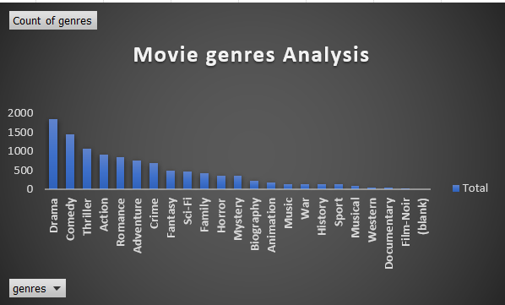
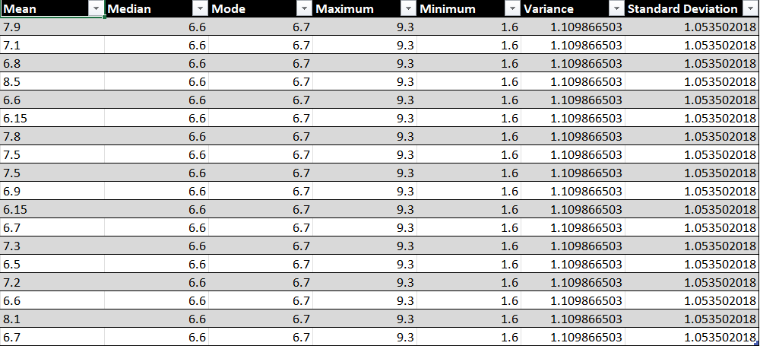
Genres chart
Once you have identified the most common genres, you can proceed to calculate descriptive statistics (mean, median, mode, range, variance, and standard deviation) for the IMDB scores of each genre.
Mean for Drama with IMDB Score – 7.2
Median for Drama with IMDB Score – 6.6
Mode for Drama with IMDB Score – 6.7
Maximum for Drama with IMDB Score – 9.3
Minimum for Drama with IMDB Score – 1.6
Variance for Drama with IMDB Score – 1.109
Std for Drama with IMDB Score – 1.053

Slide 11
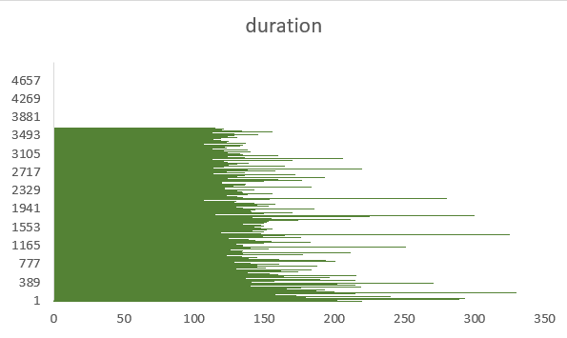
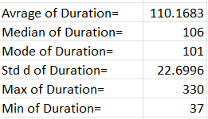
Movie Duration Analysis
Analyze the Distribution of Movie Durations:
Import your dataset into Excel, ensuring it includes columns for "Movie Duration" (in minutes) and "IMDB Score."
Calculate basic statistics for movie durations:
To get an overview of the distribution, calculate descriptive statistics such as mean, median and standard deviation for movie durations. Use the following Excel functions.
Create a histogram to visualize the distribution of movie durations:
Select the range of movie durations.
Go to the "Insert" tab and click on "Bar Chart."
Adjust the bin width or intervals as needed to represent the distribution effectively.

Slide 12
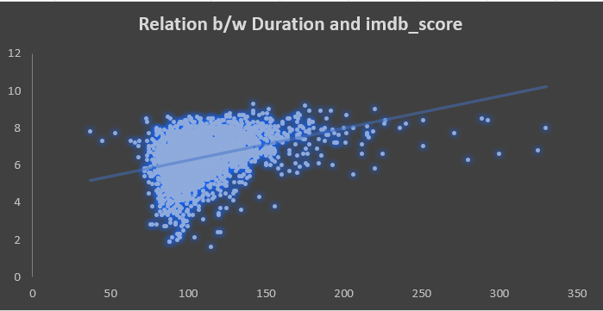
Identify the Relationship Between Movie Duration and IMDB Score:
Explore the relationship between movie duration and IMDB scores using a scatter plot with a trendline. Here's how to do it:
Select data, including "Movie Duration" and "IMDB Score."
Go to the "Insert" tab and click on "Scatter" or "Scatter with Straight Lines."
Add a trendline to the scatter plot by right-clicking on a data point, selecting "Add Trendline," and choosing the linear type of trendline.
Display the equation on the chart to see the mathematical relationship.
Calculate the correlation coefficient (Pearson's r) to quantify the strength and direction of the relationship between movie duration and IMDB scores. You can use the “CORREL” function in Excel to do this.
A positive value close to 1 indicates a strong positive relationship (as duration increases, IMDB score tends to increase).

Slide 13
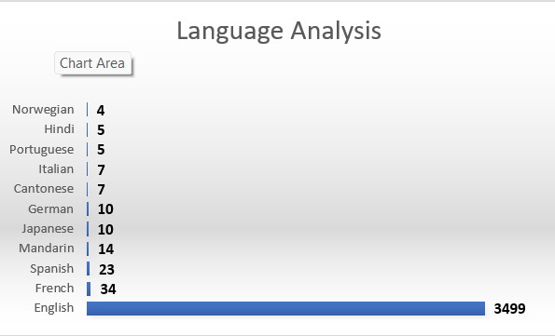
Language Analysis
Determine the Most Common Languages:
Import dataset into Excel, ensuring it includes a column for "Language" and a column for "IMDB Score.“
Calculate the count of movies for each language:
Use a PivotTable to determine the count of movies for each language. Here's how to do it-
Select dataset, including the header row.
Go to the "Insert" tab and click on "PivotTable."
In the PivotTable Fields pane, drag the "Language" field to the "Rows" area and the "IMDB Score" field to the "Values" area, summarizing it as "Count."
Now have a table showing the count of movies for each language.
Sort the table in descending order of the movie count to identify the most common languages.
Most common language are –
English : 3566
French : 34
Spanish : 23
Mandarin : 14

Slide 14
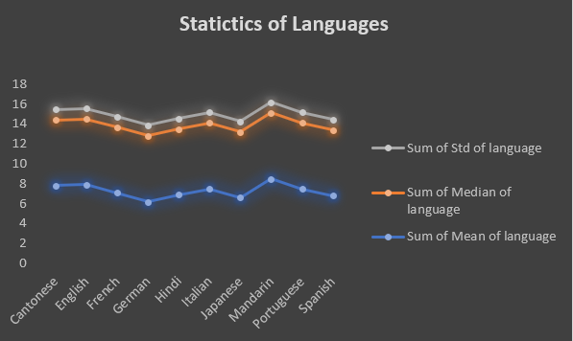
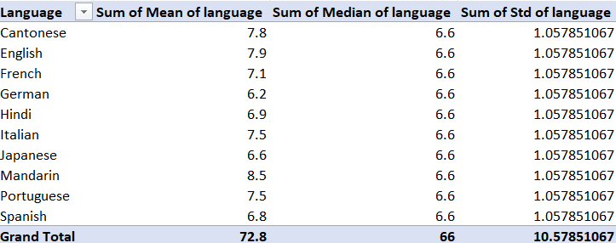
Analyze the Impact on IMDB Scores:
For each of the most common languages identified in Part 1, you can analyze the impact of language on IMDB scores using descriptive statistics.
Filter dataset to show only the rows with a specific language.
Calculate descriptive statistics for IMDB scores of each language.

Slide 15
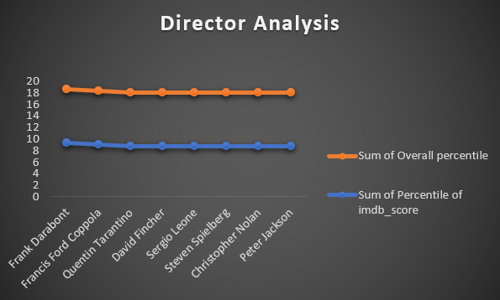
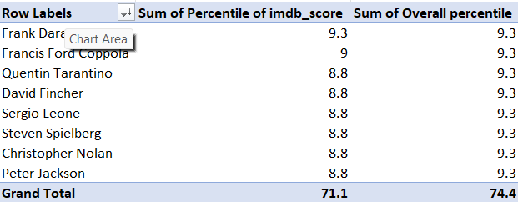
Director Analysis
Calculate the average IMDb score for each director.
Identify the directors with the highest average IMDb scores.
Compare the scores of these top directors to the overall distribution of scores using percentile calculations.
By comparing the 95th percentile of the top directors' scores to the 95th percentile of the overall scores, we can see the top 10 directors' films compare to the general distribution of IMDb scores.

Slide 16
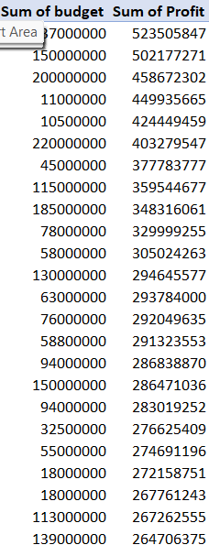

Budget Analysis
Calculate the correlation coefficient between movie budgets and gross earnings.
Calculate the profit margin (gross earnings - budget) for each movie.
Identify the movies with the highest profit margin using Excel's MAX function.
Correlation coefficient between budgets and gross earnings:
The correlation coefficient will be a value between -1 and 1. A positive value close to 1 indicates a positive correlation, while a negative value close to -1 indicates a negative correlation. A value close to 0 suggests a weak or no correlation.

Slide 17
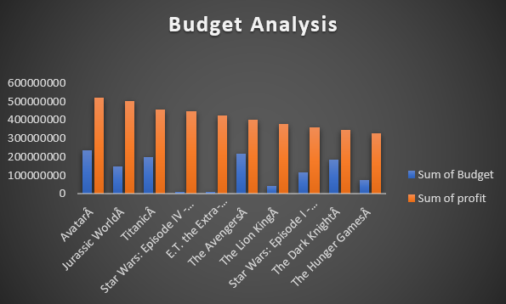
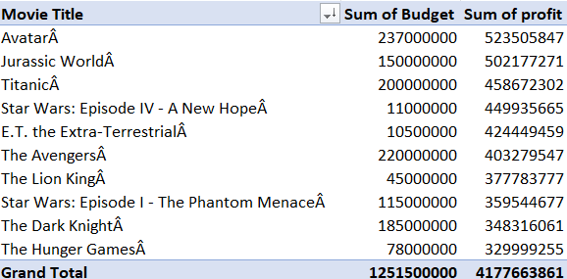
Profit margin for each movie:
This is a list of top 10 highest movie margin but in dataset the highest profit gain for movie is Avatar(523505847).

Slide 18
Result:
The insights gained from this analysis can be highly beneficial for decision-making in the movie industry. Here's how each aspect of the analysis can contribute to informed decision-making:
Movie Genre Analysis:
Understanding the most common genres can guide filmmakers and studios in genre selection for their upcoming movies.
Knowing the impact of genres on IMDb scores helps in predicting audience reception and success.
Movie Duration Analysis:
Recognizing the relationship between movie duration and IMDb scores can help filmmakers decide on the optimal length for their films.
Filmmakers can make creative decisions regarding the pacing of the movie, considering the influence on audience ratings.
Language Analysis:
Recognizing the most common languages in movies is crucial for targeting diverse audiences.
Analyzing the impact of language on IMDb scores can aid in language selection for international releases.

Slide 19
Result :
Director Analysis:
Identifying top directors with high IMDb scores can assist studios in making directorial choices.
Studios can gauge the potential success of movies by collaborating with established and highly-rated directors.
Budget Analysis:
Understanding the correlation between budget and earnings is vital for budget allocation.
Identifying movies with the highest profit margins can provide insights into financial strategies and return on investment.
This project equips stakeholders in the movie industry with valuable data-driven insights to make informed decisions, enhance the quality and success of their movies, and maximize both IMDb ratings and financial success. It serves as a valuable tool for strategizing and optimizing various aspects of movie production and marketing.

